Slide 1
1
Attendance Taking
System
Done by: Yong Teng & Wei Jie

Slide 2



Introduction
This project is about making school campus efficiency and time saving by taking attendance using paper and pen.
Pen and Paper
Manual Headcount
Repetitive

Slide 3



Scope
Reduce time taken
Efficiency
Preventing any falsification during attendance taking
User friendly
Easy to use

Slide 4
<It’s Time To Look Into Our> <Project>

Slide 5
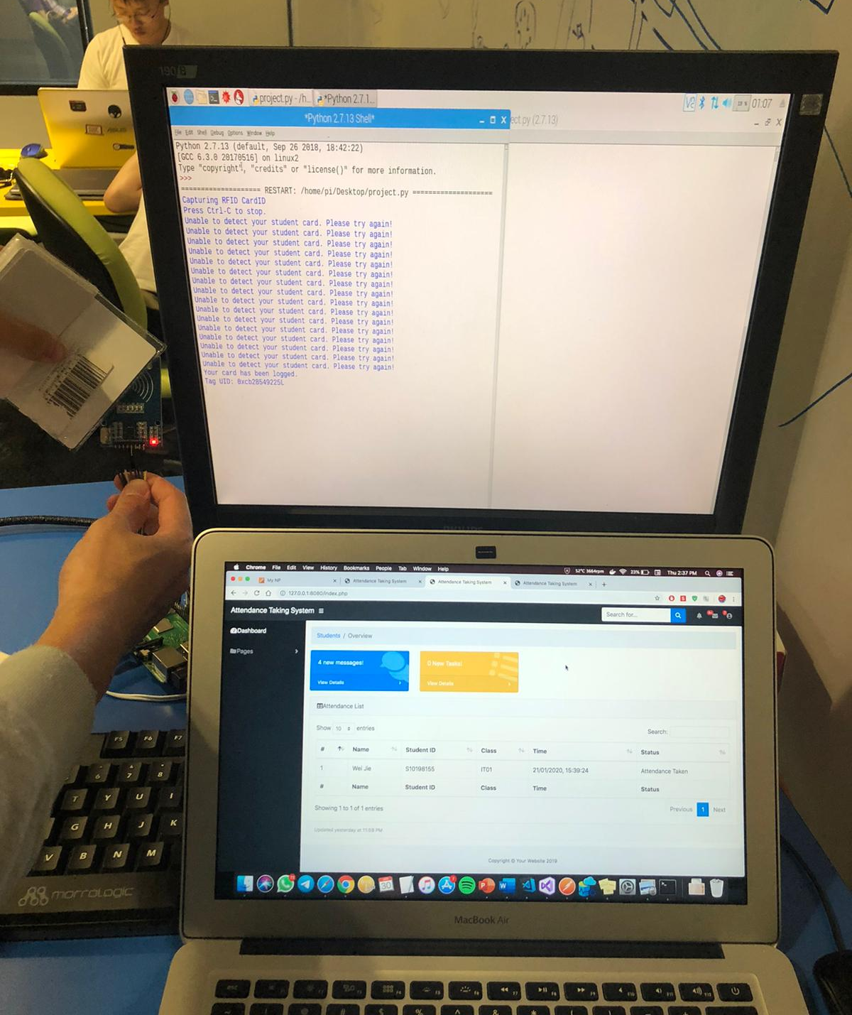
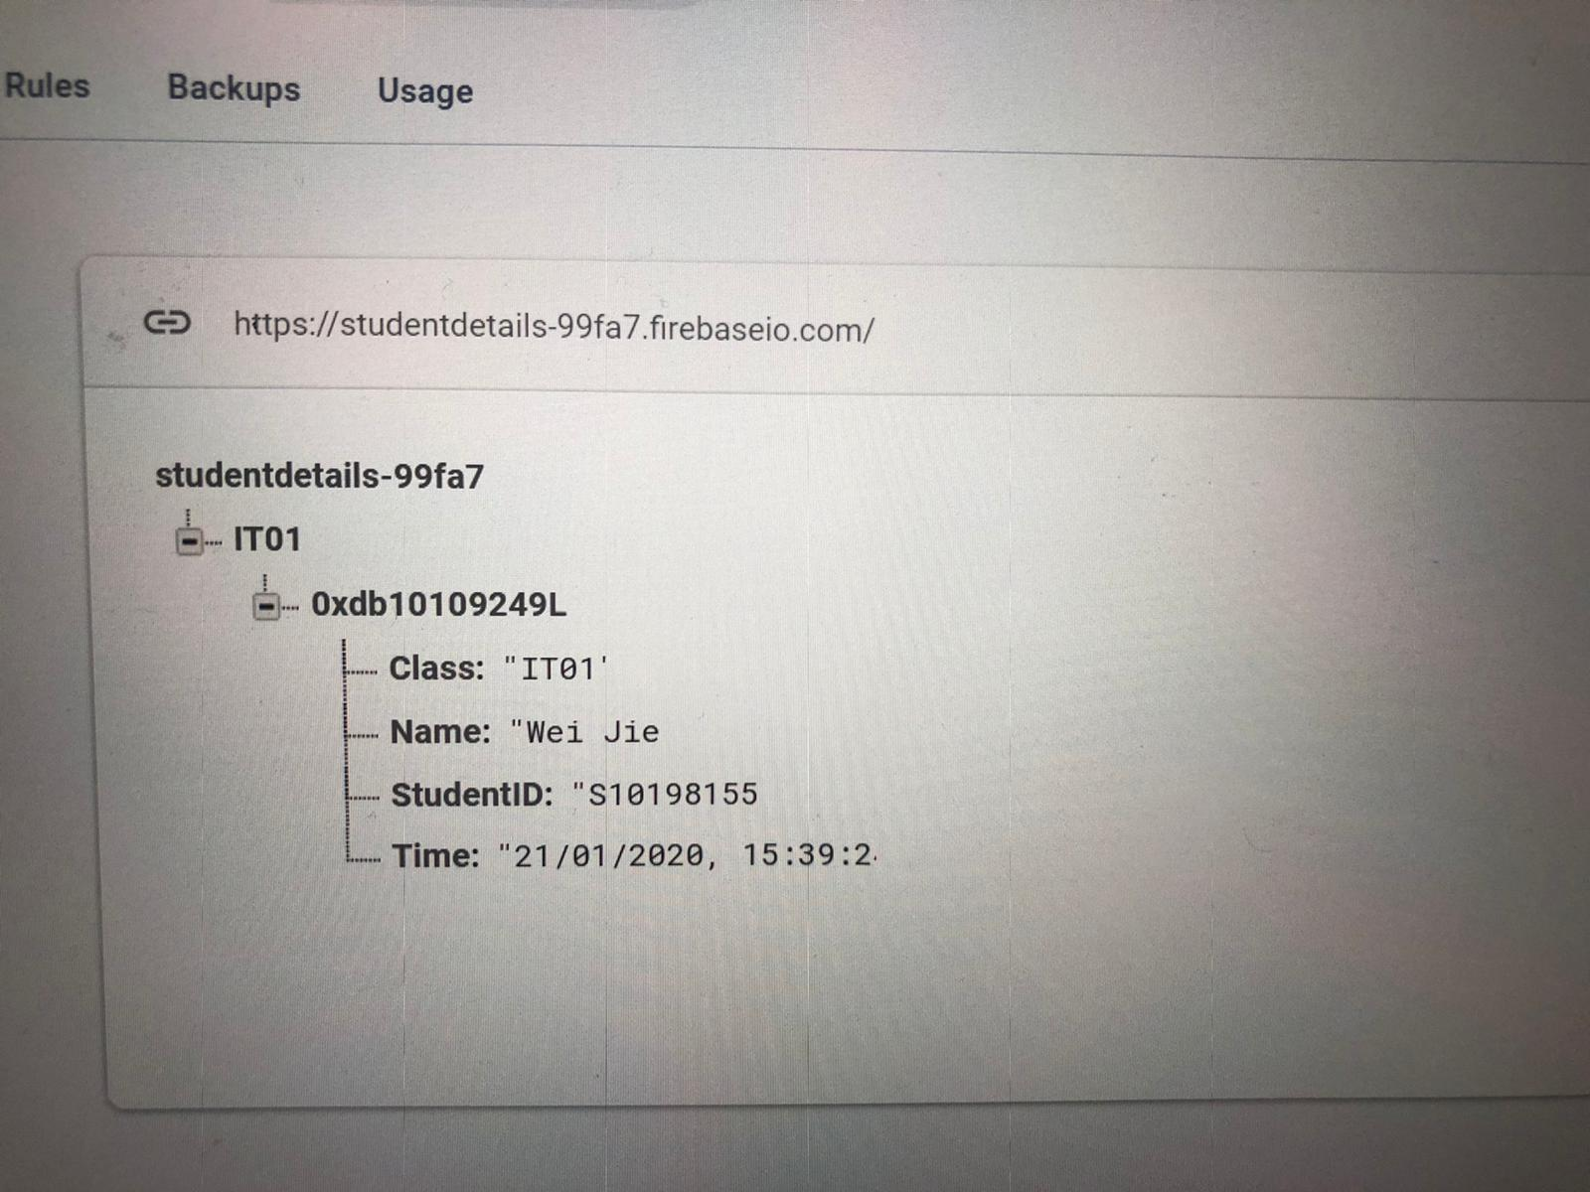
Step 1
Student tap their student card on the NFC device
Keep a entry record into firebase

Slide 6
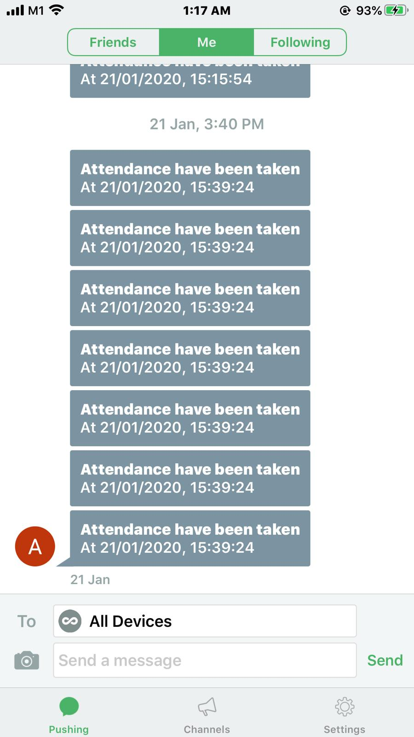
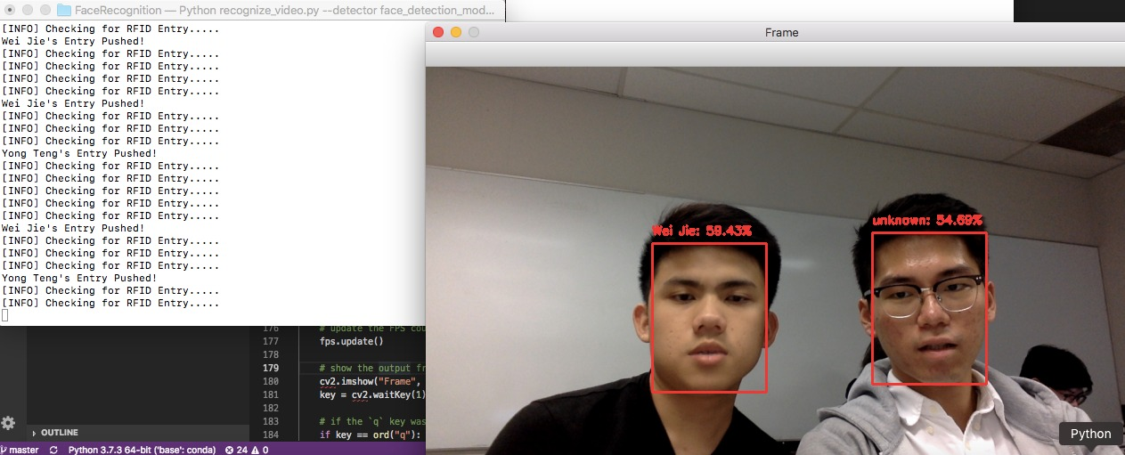
Step 2
Face Recognition to double check the student face matches
Send a notification through pushbullet app to student

Slide 7
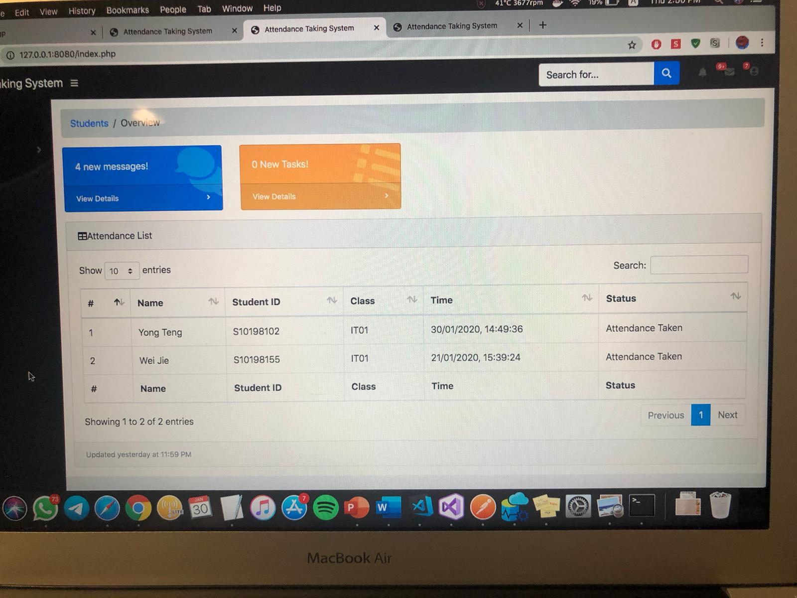
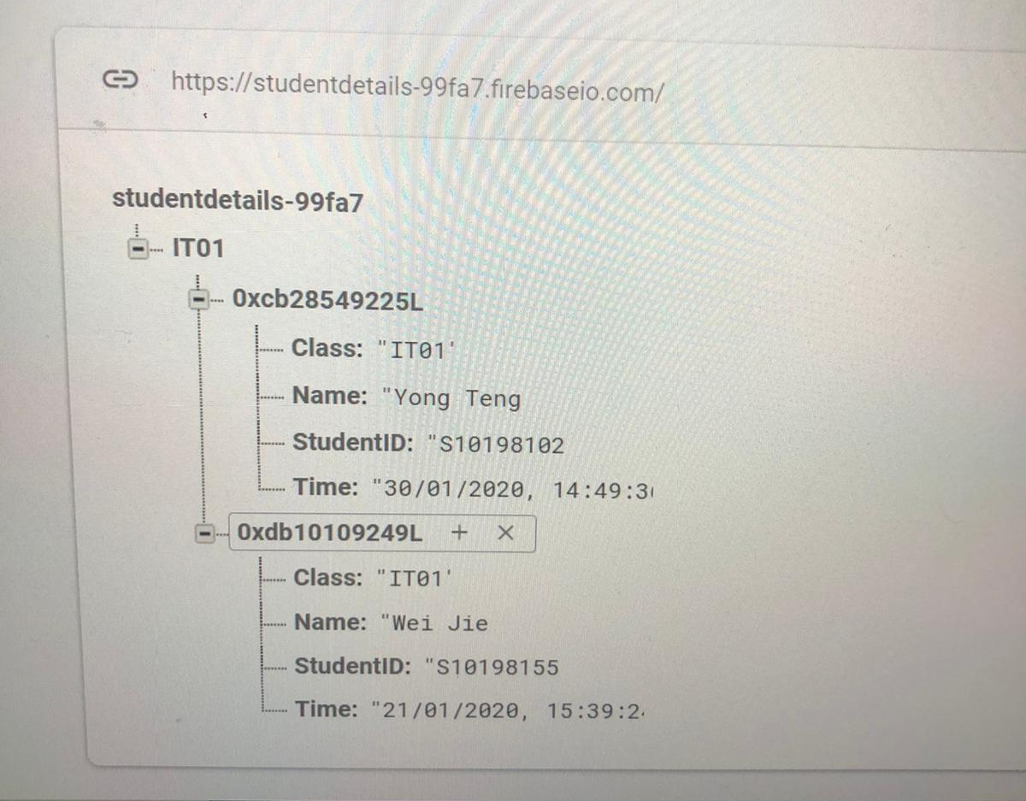
Step 3
Lecturer can login to web application to check student attendance
A record will be taken through firebase

Slide 8
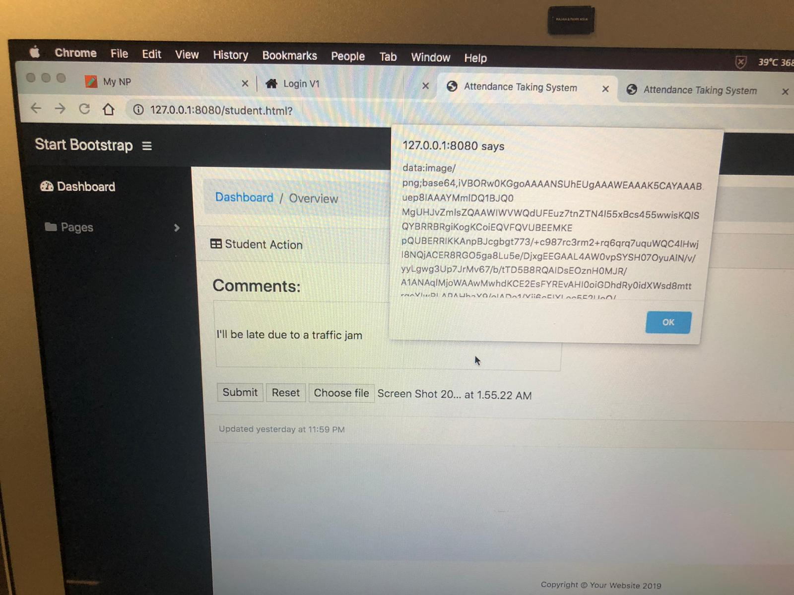
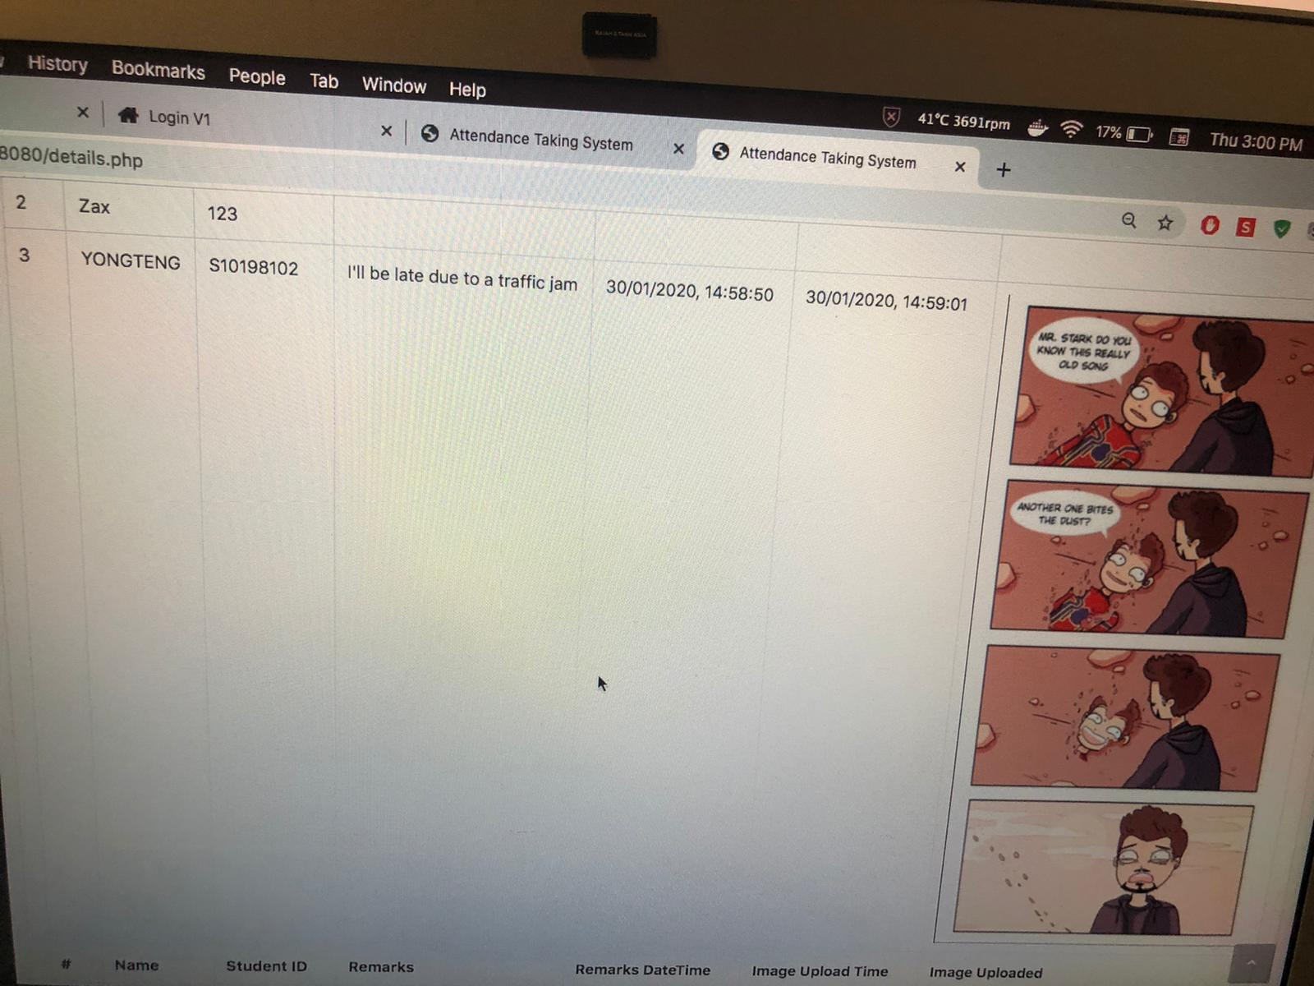
Step 4
Send a message to lecturer through web application
Upload document to lecturer through web application

Slide 9
It’s DeMo Time!!

Slide 10

Thank You!

